Slide 1


Evictions in NYC
Michaels Pod
Mohammed, Rosa, Jasmin, Jason, Bhumika
Evictions in NYC
Notes:
Mohammed, Rosa, Jasmin, Jason, Bhumika

Slide 2
Agenda
Introduction
Evictions by Boroughs
Evictions Before, During, and After Pandemic
Seasonal Effects On Evictions
Takeaways
Notes:
M

Slide 3
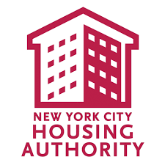
Introduction
Our client is NYC Housing Authority.
In New York State, an eviction of a tenant is lawful only if an owner has brought a court proceeding and obtained a judgment of possession from the court.
The pandemic started on January 10, 2020 and we wanted to take a closer look on how that impacted NYC on evictions
Notes:
M
Regarding 5 boroughs,
Covid impact: fear of unknown disease, sick, laid off, businesses closing, no income source while workplace closed

Slide 4
Hypothesis
We think that Manhattan may have the highest eviction rates throughout the pandemic due to that already being an very expensive area to live in.
Notes:
M

Slide 5
Questions?
Evictions over time in NYC? Before, During and After COVID
What Season had the most evictions, which had the least?
Types of housing people are being evicted from
How did Covid-19 influence housing security in NYC?

Slide 6
Before Covid, During, After Covid?
Before Pandemic what was the eviction rate?
(Postal Code, Borough, or the Whole State)
How Evictions varied before,during, and after covid?
(3yr Span)
What Season had the most evictions, which had the least?
Types of housing people are being evicted from

Slide 7
How we can reduce the amount of evictions in an area and or which area can we add affordable housing to so we can reduce the amount of evictions and have less homelessness?
By borough- Bronx most evi. 2017-2021
Top 5 most evicted area by zip codes(Need Affordable Housing)
Comparison ( Before Pandemic and after panorama)

Slide 8
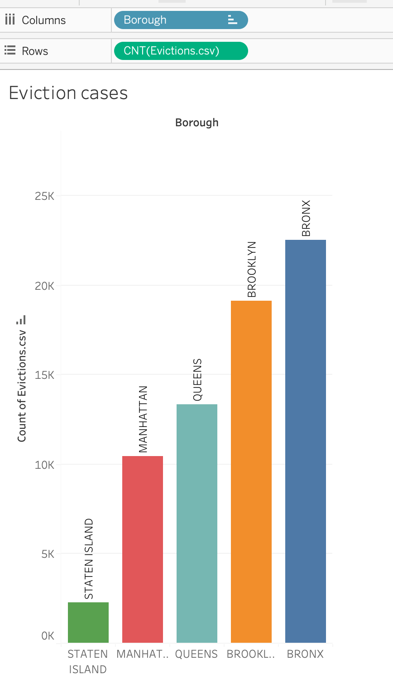
Eviction cases by Borough
Bronx in general has 11x higher eviction rate than Staten Island
Notes:
Rosa
Bronx ~23k, Staten Island ~2k
67k eviction happened from 2017-2022

Slide 9
Eviction cases by Borough
In general, The Bronx has the highest number of evictions in total, and Staten Island has the least number of eviction cases.
Evictions can include a tenant being displaced from their home, or a store closing down. To that end, let’s check out how many evictions are from residential buildings, and which are from commercial buildings.
Notes:
R

Slide 10
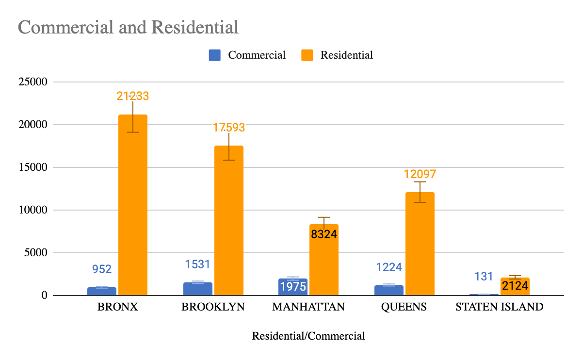
Types of buildings people are being evicted from
Notes:
R
More in commercial:
stricter deadlines for rent due dates?
More empathy from residential owners (due to sickness from COVID or lack of job due to COVID)?
More evictions in commercial for Manhattan, Brooklyn then Queens-> Manhattan has more businesses so more evictions for commercial in Manhattan compared to other boroughs
More in residential for Bronx,

Slide 11
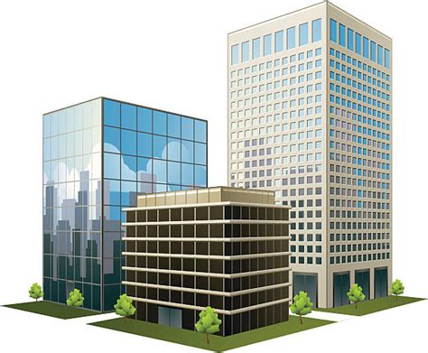
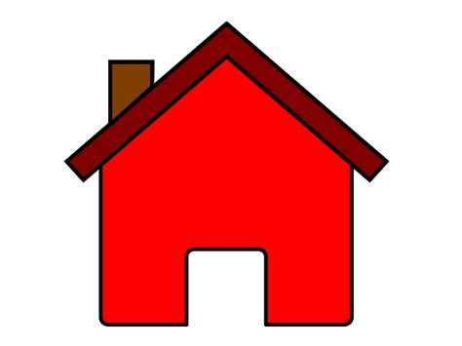
Evictions by Building Type
The majority of eviction cases over the five boroughs are from residential households over the last five years.
It should also be noted that The Bronx which leads in evictions overall leads only in residential. The Bronx is the second lowest in commercial behind Staten Island,
The borough that leads in commercial buildings is actually Manhattan.
Let’s narrow our focus and see the cases over the last five years.
Notes:
Rosa

Slide 12
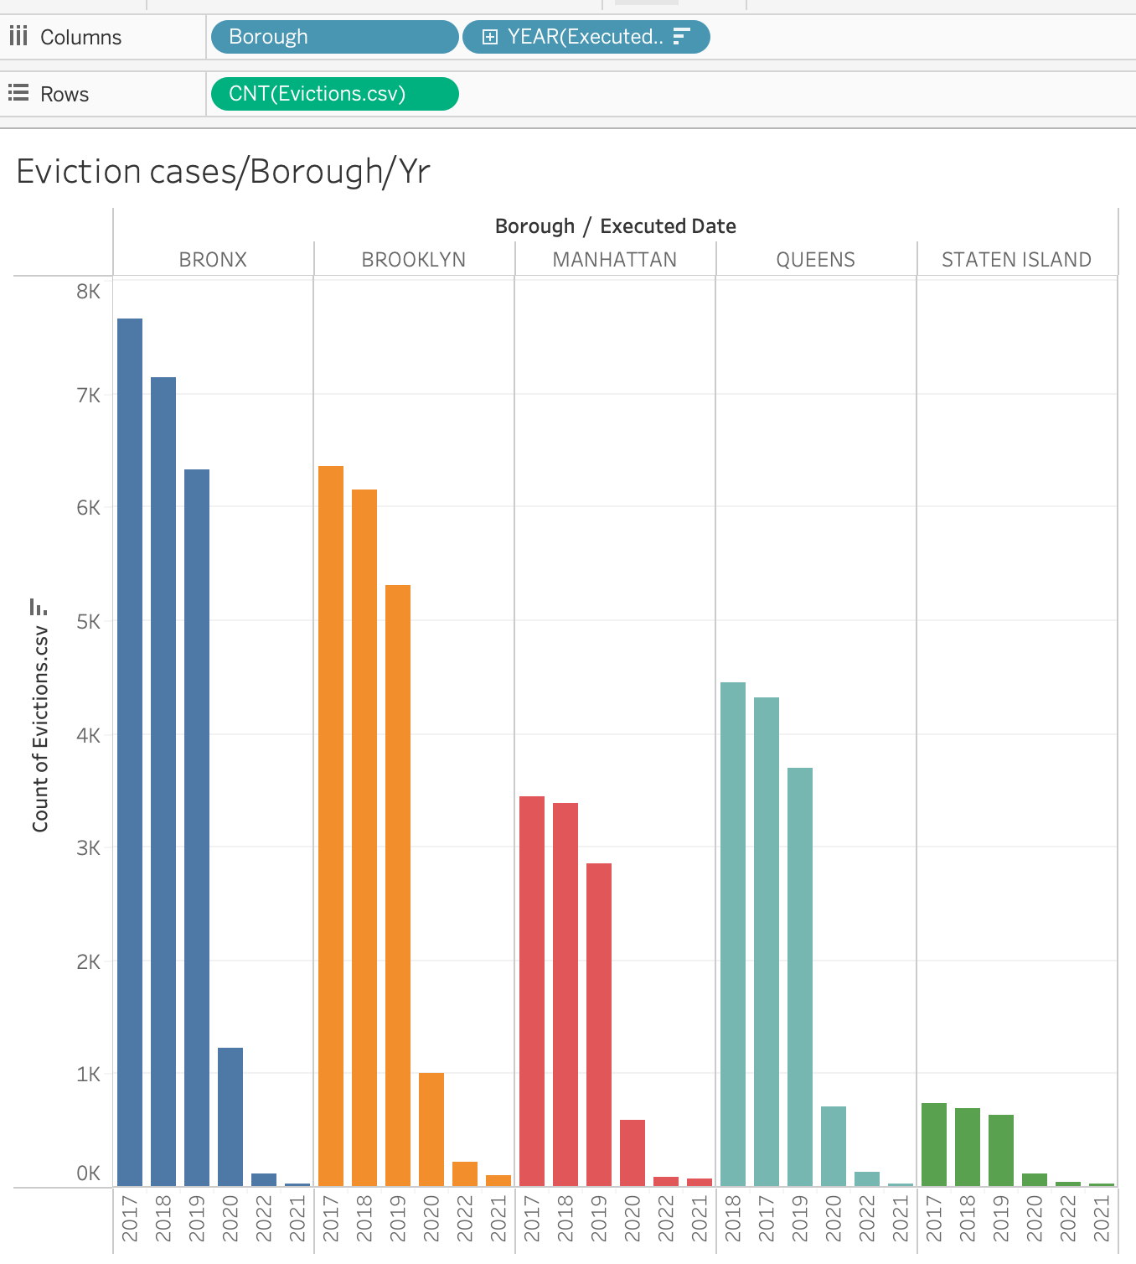
Eviction cases by Borough through the years
For each year, regardless of COVID affecting eviction rates, Bronx had the highest eviction rates among other boroughs in NYC
Notes:
Bhumika
Years: 2017 to 2022
Similar trend for all the 5 boroughs except during covid
Covid drastically decreased the eviction rates -> next slide

Slide 13
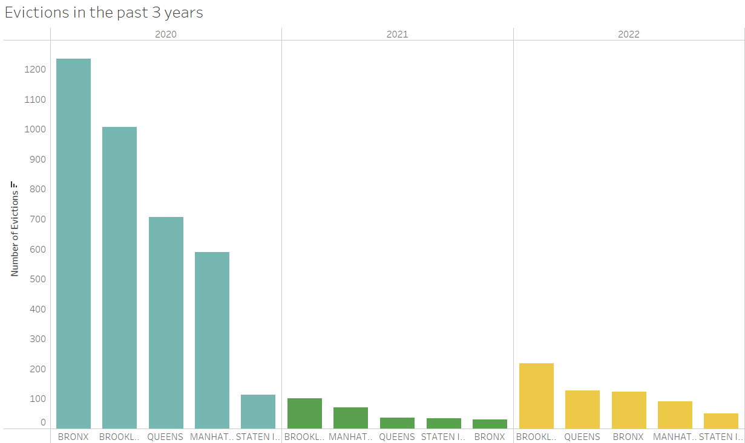
Eviction trends by Boroughs
The data suggests that The Bronx has the highest number of evictions followed by Brooklyn, Queens, Manhattan, and then Staten Island.
This trend holds true for each year except for 2021 and 2022 (when COVID-19 was prevalent the most)
Notes:
B
Zoomed into the 5 boroughs for 2020, 2021 and 2022 to see better
During covid, Brooklyn was more in 2021 & 2022, followed by Manhattan in 2021 and Queens in 2022

Slide 14
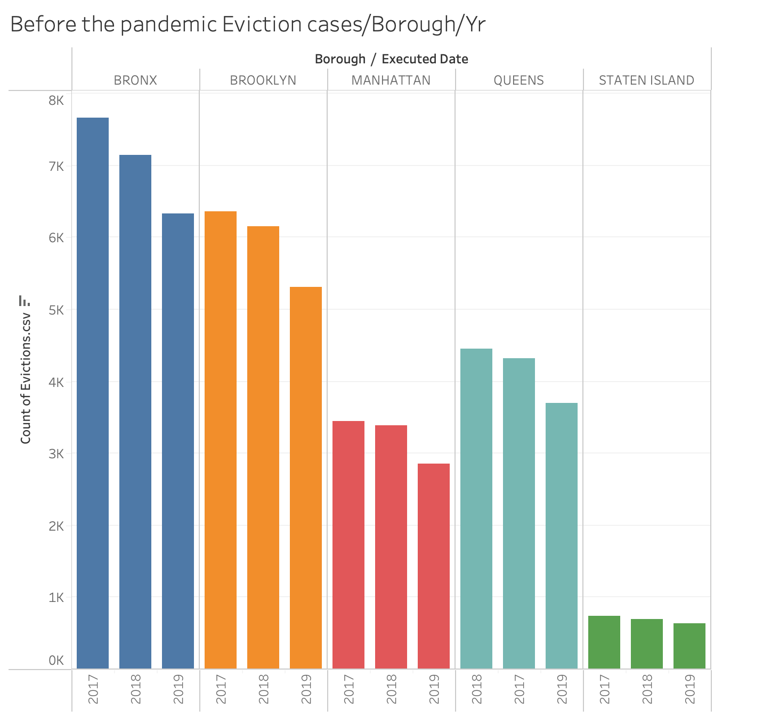
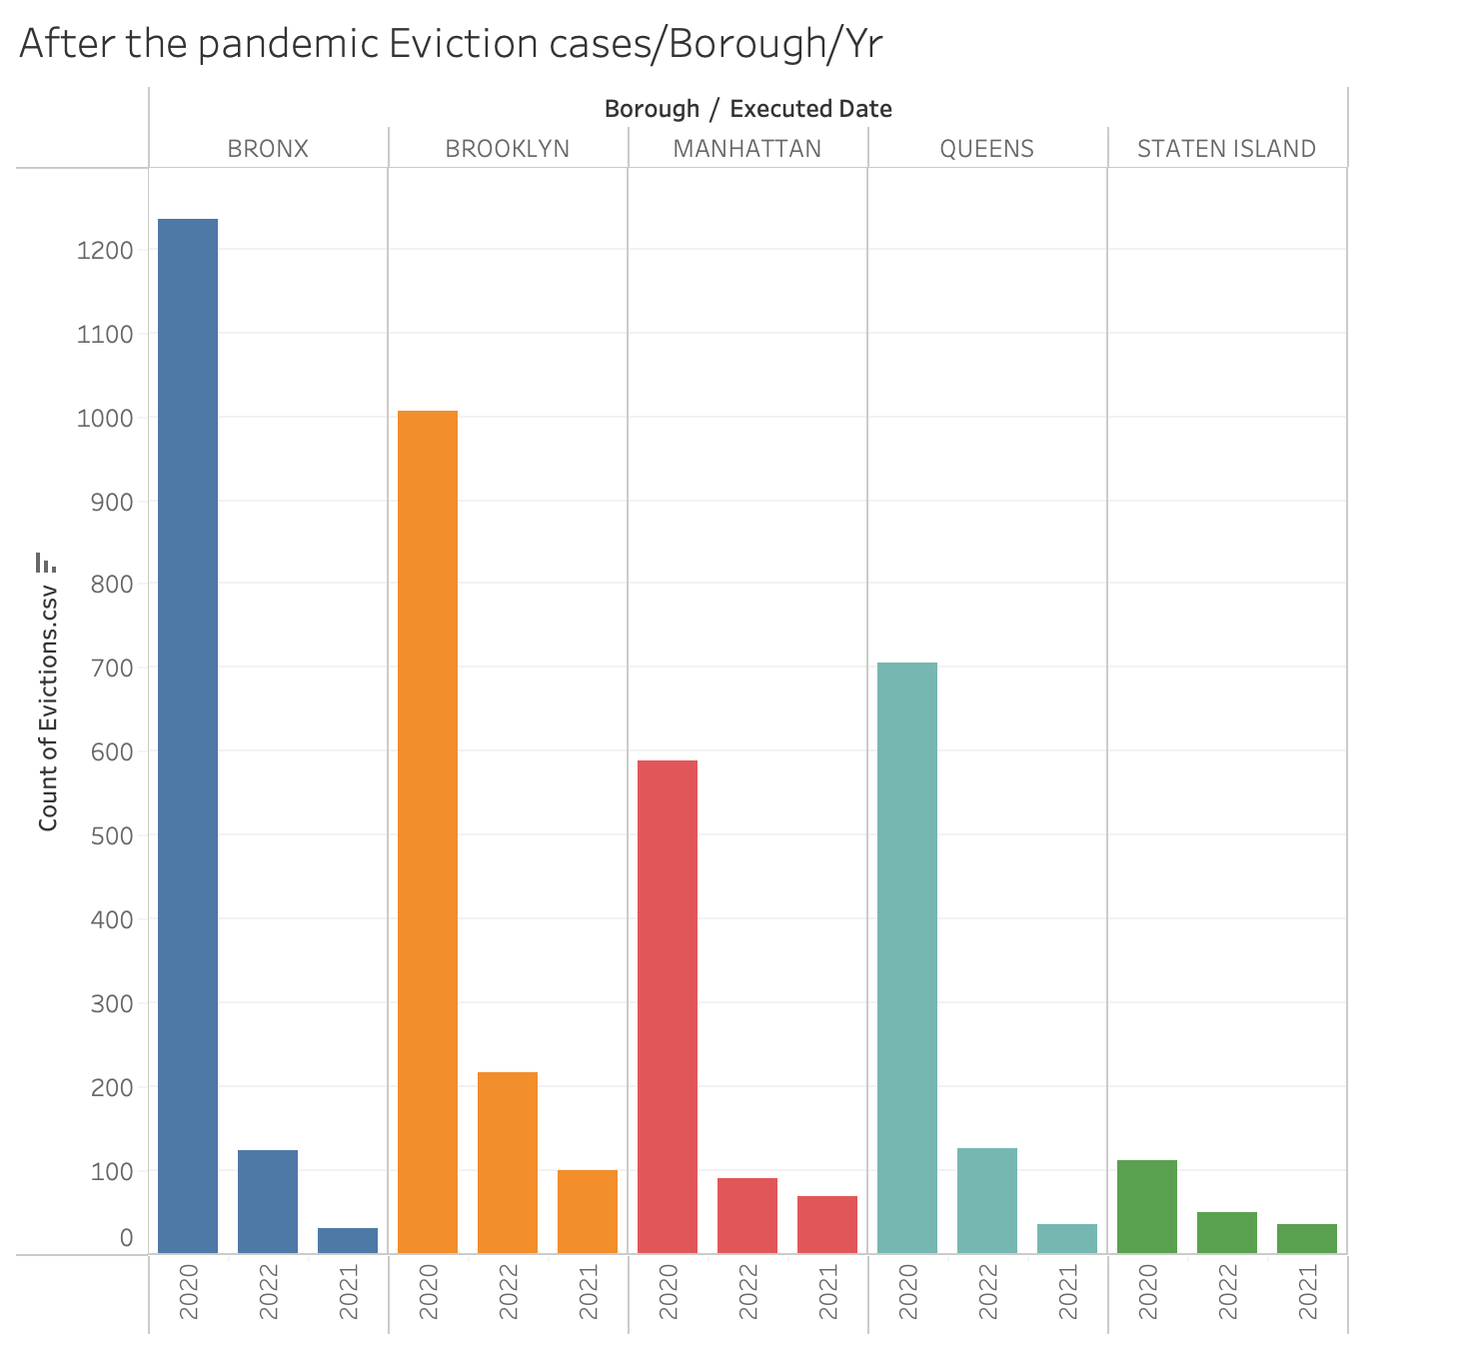
Notes:
B
https://hcr.ny.gov/covid-19-eviction-protections-tenants
The Tenant Safe Harbor Act, Chapter 127 of 2020, protects tenants from eviction for failing to pay their rent that came due during the covered period from March 7, 2020 through January 15, 2022, if they suffered a financial hardship due to COVID-19

Slide 15
Evictions by Boroughs
Notably, for the year of 2021 and 2022 Brooklyn is leading the boroughs in evictions.
It would be worth looking into is the number of evictions from 2020 to 2021 more closely.
Notes:
JASON

Slide 16
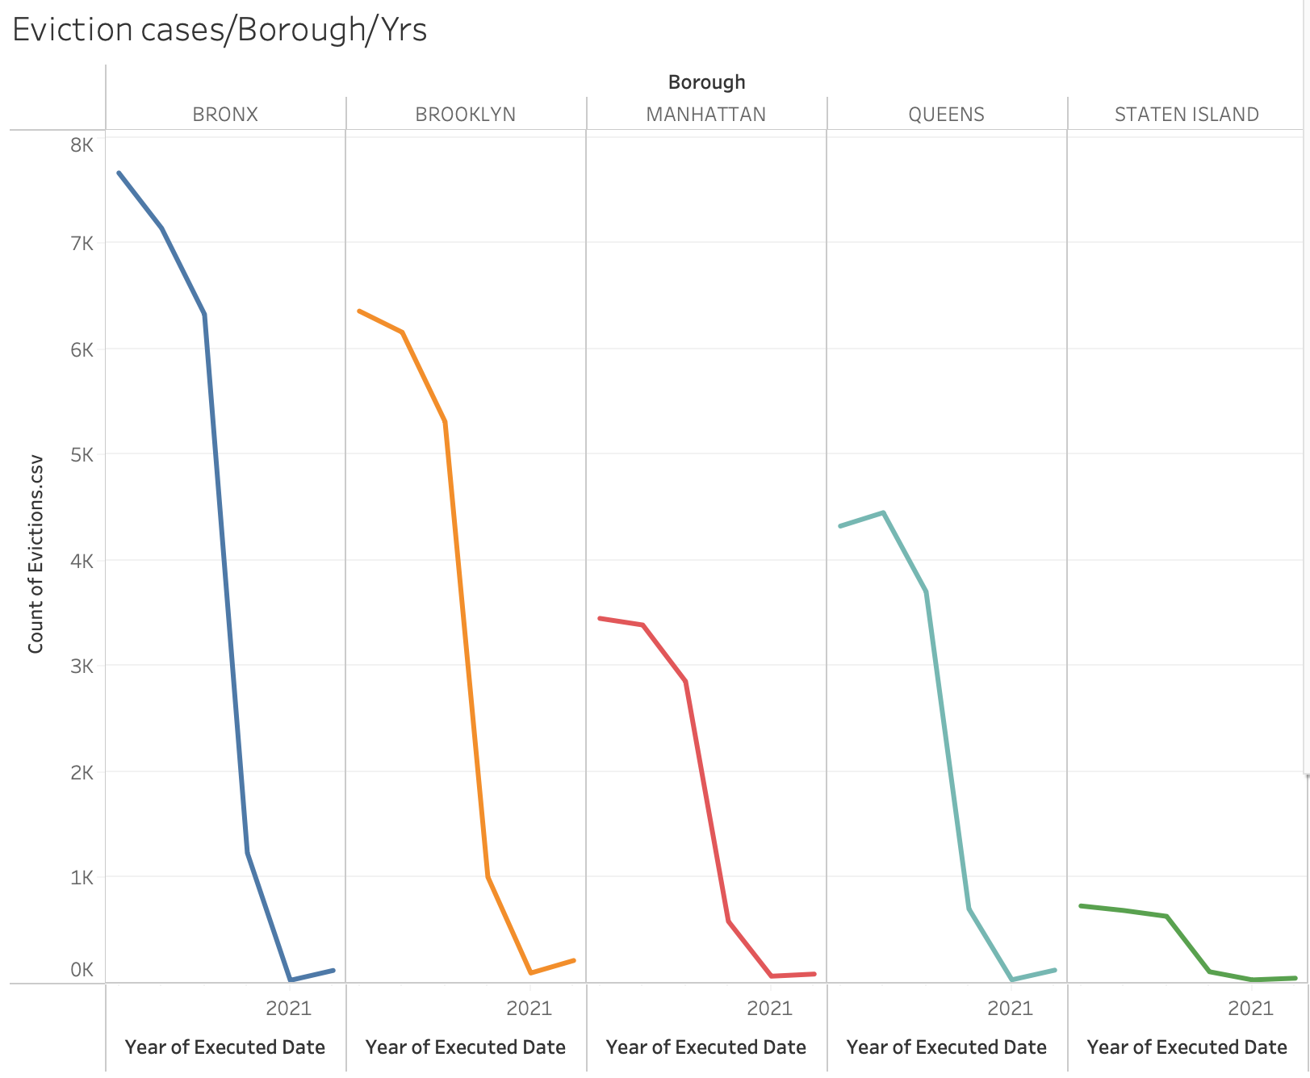

Slide 17
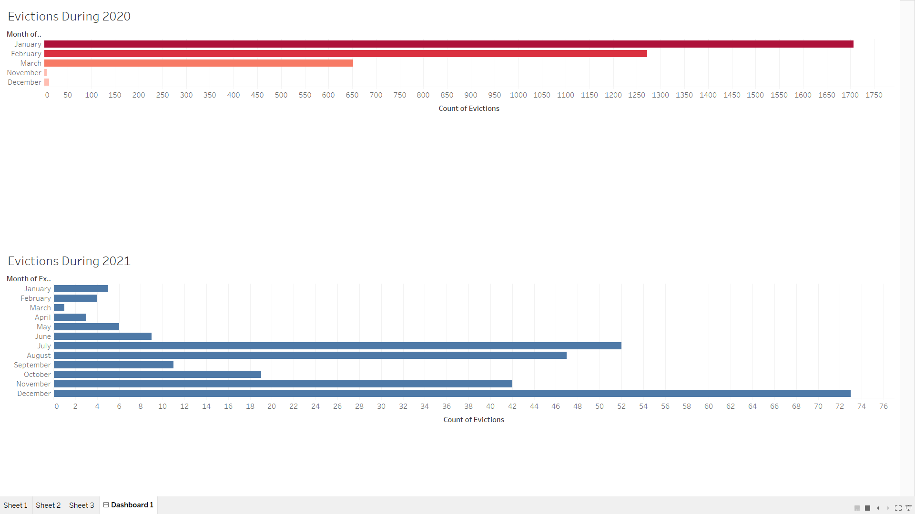
Evictions during the Pandemic
Notes:
JASON

Slide 18
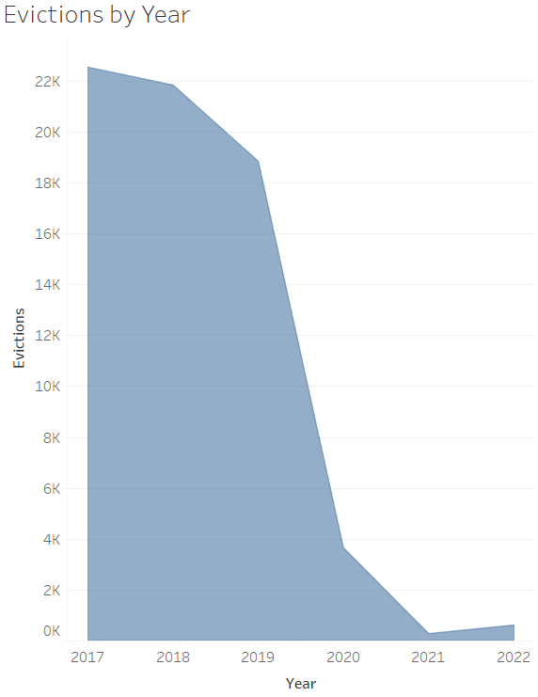
Evictions by the Years
The Tenant Safe Harbor Act, Chapter 127 of 2020: from March 7, 2020 to January 15, 2020
It protected tenants from getting evicted if they suffered a financial hardship due to COVID -19
Sharp decline in evictions in 2020
Notes:
JASON
https://hcr.ny.gov/covid-19-eviction-protections-tenants
The Tenant Safe Harbor Act, Chapter 127 of 2020, protects tenants from eviction for failing to pay their rent that came due during the covered period from March 7, 2020 through January 15, 2022, if they suffered a financial hardship due to COVID-19

Slide 19
Evictions during the Pandemic
Looking at the number of evictions month by month directly preceding the pandemic in March 2020, the number of evictions are much higher than it was in March.
This is the case because according to the The Tenant Safe Harbor Act, landlords are prohibited from evicting tenants due to Covid from early March 2020 to mid January 2022.
We also see that there have been no evictions from April to October and evictions have resumed in November as the year is nearing its close.
Notes:
JASON
It could be the case that the number of evictions have dropped due to the massive amount of people who have been unemployed during that period.
Evictions have not been in the 100s even now. This could possibly be a new trend or rather a new normal for NYC.

Slide 20
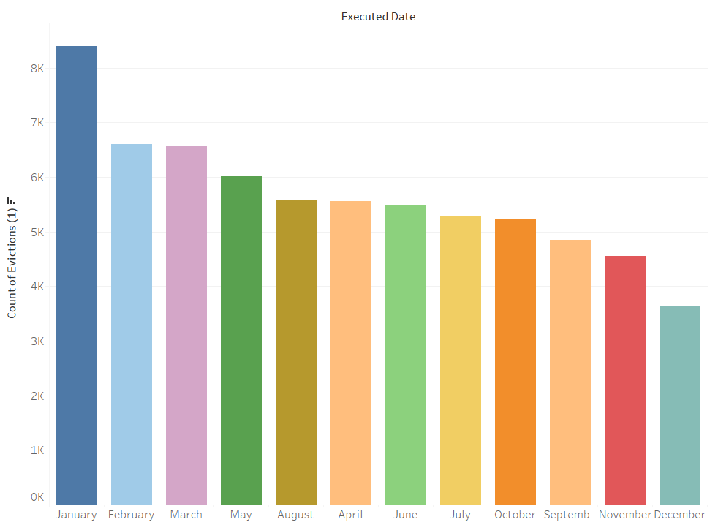
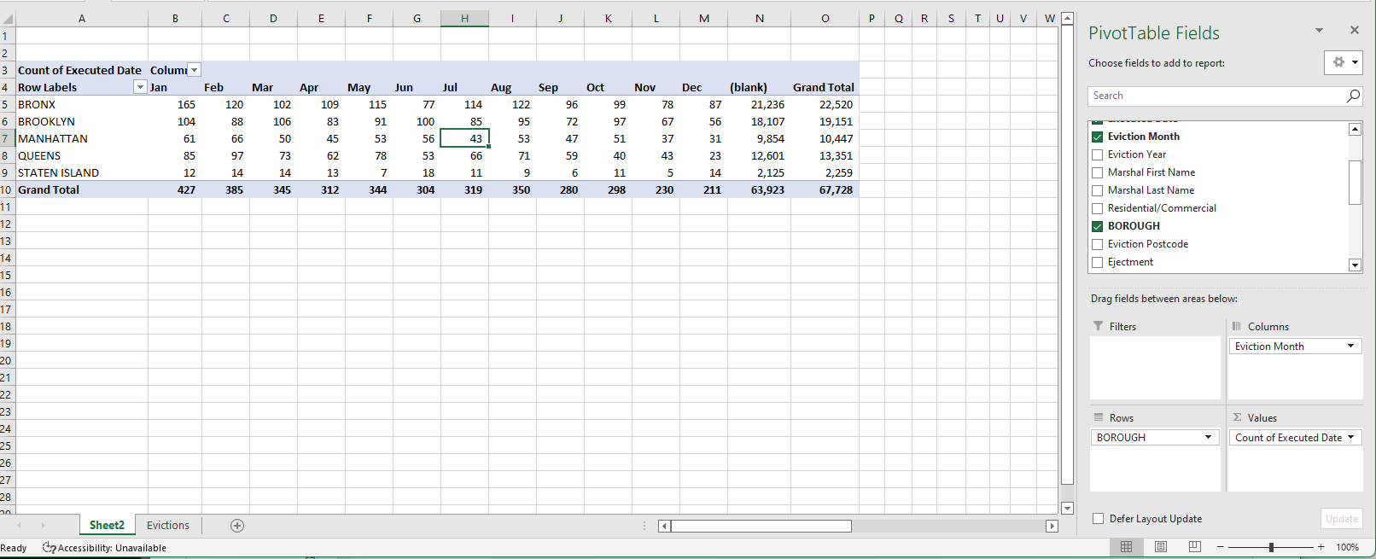
Seasonal effects on evictions
Notes:
JASMIN

Slide 21
Seasonal trends
Evictions seem to occur the most on January, likely due to the new year rolling around and the holiday season comes to a close.
To take a closer look at The Bronx, which areas are seeing the most evictions specifically?
Notes:
JASMIN
What options would people getting evicted get when majority of evictions occur in winter months of January

Slide 22
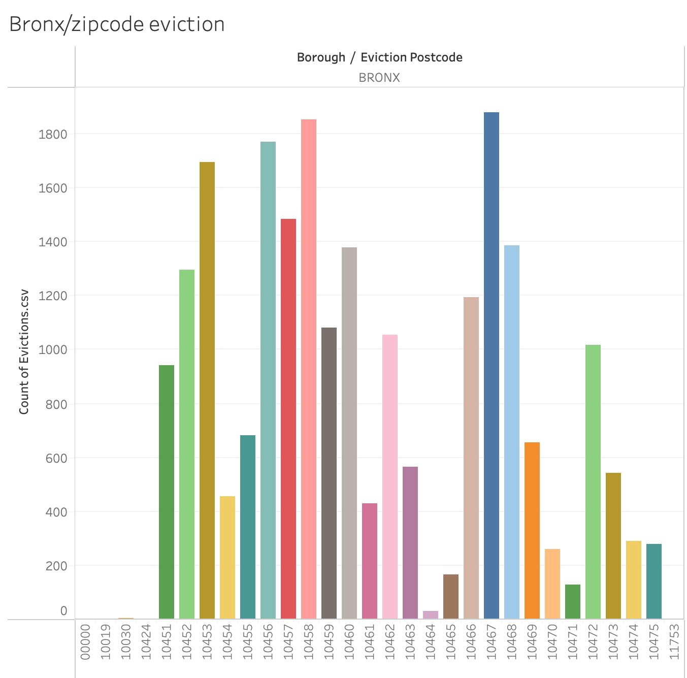
The zip codes with more eviction in the Bronx are
10467 - Williamsbridge
10458 - Belmont
10456 - Morrisania
10453 - Morris Heights
10457 - Tremont
Williamsbridge seems to lead in eviction cases in the Bronx at over 1800.
Notes:
JASMIN

Slide 23
Williamsbridge seems to lead in eviction cases in the Bronx at over 1800.

Slide 24
Takeaways
Mid-Winter to early spring we have the highest evictions
The Bronx has the highest evictions during 2017-2020
Before and during the pandemic the Bronx had the highest evictions and After the Pandemic Brooklyn had the highest evictions.
In the end we came to the conclusion that the Bronx had had the highest amount of evictions.
Notes:
JASMIN

Slide 25

Conclusion
Recommendation- Tenants should go to court when they get eviction notice.
We need to do more research on specific tenant incomes to then create programs that can assist tenants with renting or owning their place of residence.
Funded by NYCHA of Course.
Notes:
JASMIN
More resources: more data on income,

Slide 26
Links/ Resources
https://nycha.maps.arcgis.com/apps/webappviewer/index.html?id=41c6ff5e73ec459092e982060b7cf1a1
https://hcr.ny.gov/covid-19-eviction-protections-tenants
https://otda.ny.gov/programs/emergency-rental-assistance/faq.asp#faq-tenant

Slide 27
Any Questions?

